Slide 1
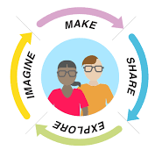




Computer Science Workshop
Be a coder for the day.
Solve problems.
Build skills.

Slide 2

Lauriann’s STEM Club
We raise awareness for STEM (Science,technology, Engineering & maths)
Promoting STEM in Schools through our school outreach by delivering fun engaging workshops, activities and events
We encourage more Women and Minorities into STEM
Founded by Lauriann who has a background in Civil Engineering
Based in the London Borough of Bexley
Lauriann's STEM Club
www.lauriannsstemclub.co.uk
Join us on: Facebook|Instagram|Youtube
Notes:
For this slide you will need to explain your delivering the workshop today on behalf of/part of Lauriann's STEM Club and mention a few points on who we are and what we do.
Who we are/What we do
We raise awareness for STEM (Science, Technology, Engineering, and Math) through our schools outreach programmes based in the London borough of Bexley and outer areas.
We aim to encourage and support young women, and minorities into STEM through providing fun engaging STEM activities, workshops and events in schools
Lauriann is the founder who has a background in Civil Engineering

Slide 3



Outline of the Session
About Me and My Job
Software Development in the Real World
DIY - Do It Yourself!
Build a FakeBook News Feed
Design
Code
Test
Evaluate
Feedback
Notes:
Introduction - 5 mins: Introduction into the outline of the lesson and introduce yourself & Introduce Lauriann's STEM Club
Presentation – 15 mins: 5 mins Career talk + 10 mins Lesson on Software Development.
Activity – 65 mins: 15 mins Analysis & Design + 35mins Building + 5 mins Testing + 15 mins Retrospective
Feedback forms – 10 mins: Students fill in feedback on how the session went.

Slide 4

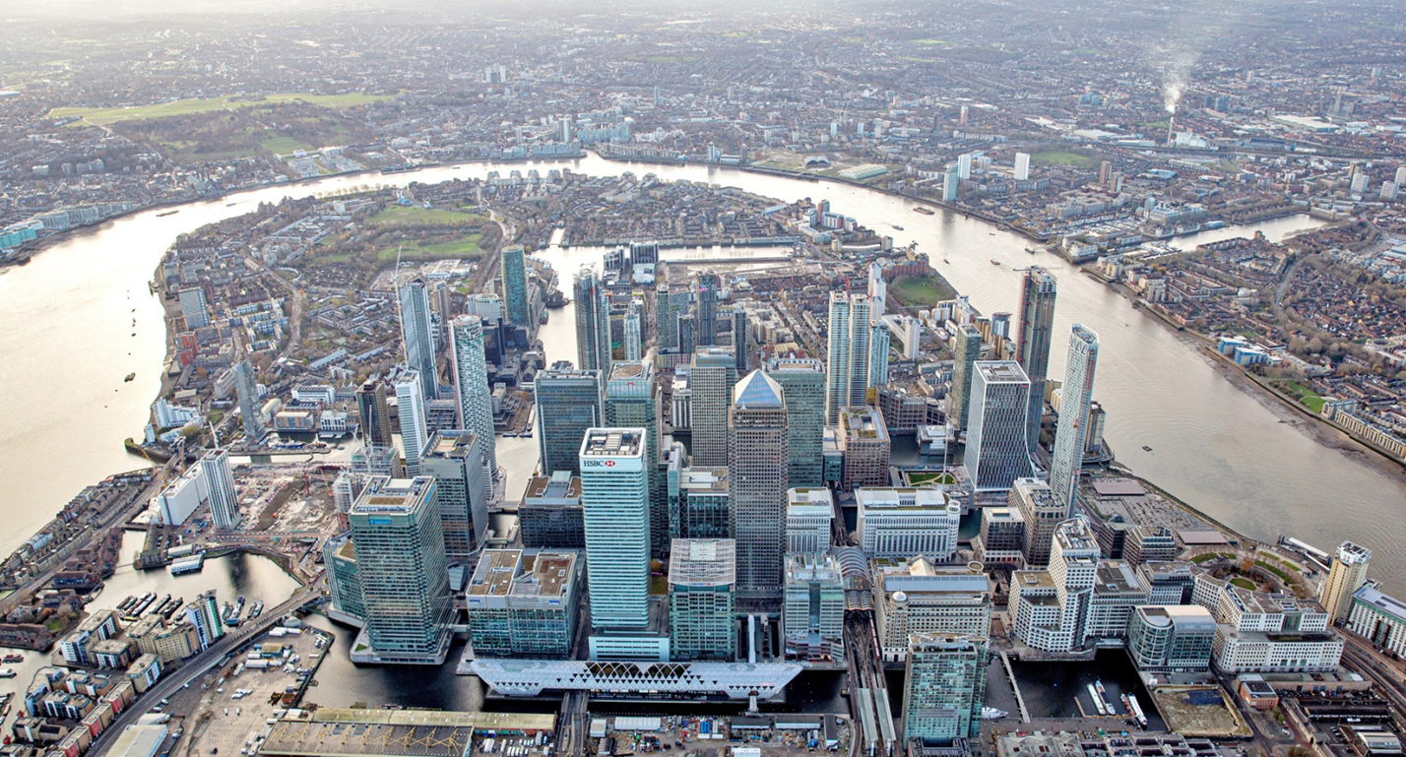
About Me - Jackie
I work as a Software Developer at Credit Suisse in Canary Wharf
Credit Suisse is a Global Bank
- 48770 employees
- head office in Zurich, Switzerland
- offices in 50 countries including
China, India, Poland,
Singapore, UK, USA,
Brazil

Slide 5

About My Job - Software Developer
Also called:
Application Developer
Software Engineer
Programmer
Coder
A Software Developer build apps.
In a bank like CS there are literally
thousands of apps!
(last count, 26,478)
Notes:
This is just a picture I found on the internet, it shows what it feels like to be a software developer. We do a lot of teamwork so you’re always talking to people.

Slide 6





About My Job - Software Developer
I’ve been working as a programmer for 20 years.
I’ve worked on:
Road Accidents - An app which analyses the road accident information by the number of fatalities, finds the most dangerous sections of roads so that engineers can visit those sections of roads to see what can be done.
Vehicle Tracking - Apps which process messages from units installed on vehicles, detects accidents and automatically contacts 999 to send an ambulance to the vehicle’s location.
Energy Trading - Oil/Gas/Airline Fuel - Apps which calculate the correct price of trades and highlight risks to the traders.
Liquidity Management - Apps which take the banks cash commitments, run a number of hypothetical scenarios to see if the bank will go bust.
FX Trading - Apps which analyse the trades which have already been done, calculating the correct price of the trades and highlight risk to the traders. App which checks if the price that was charged to clients was a fair price.
PythonC#
C++
Java
VBA
SQL
Notes:
Things have changed a lot in Banking since I started - We used to build apps to help traders make more money and be more competitive, now we build a lot of apps for regulatory reporting - to prove that bank is being sensible with clients money and that it won’t collapse.

Slide 7
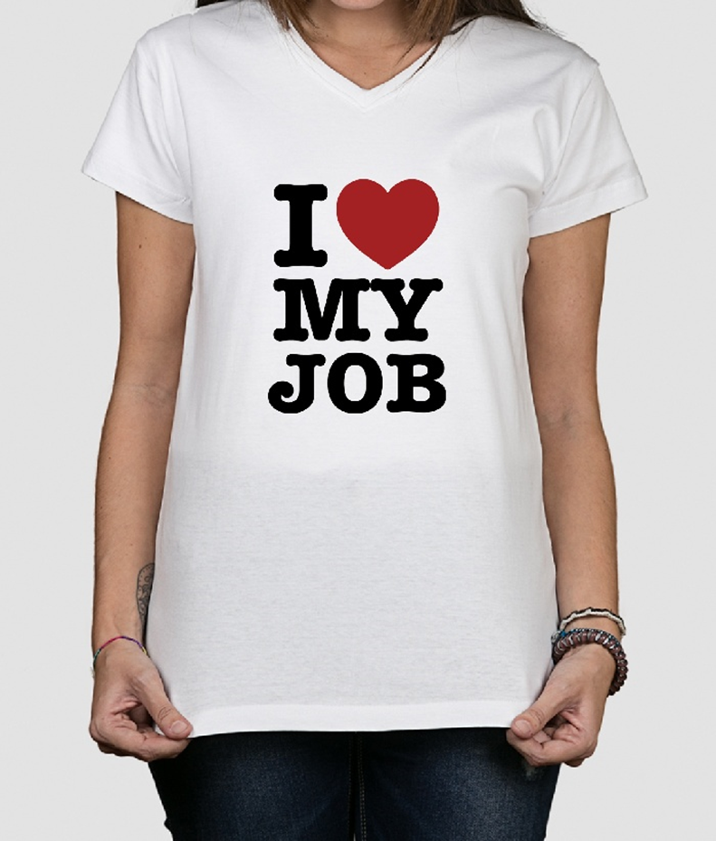
About My Job - Software Developer
It’s fun!
Solve Problems
I work with ppl
Always Learning
I enjoy coding
Helping People

Slide 8
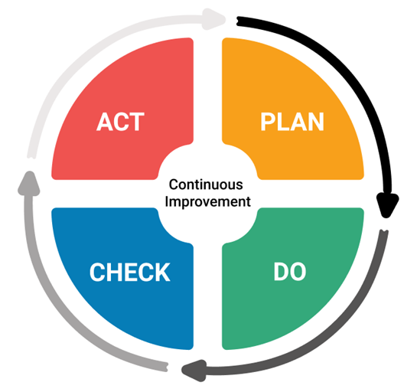
IRL => The PDCA Cycle - Continuous Improvement
Retrospective
-How did it go?
-Can we improve?
Requirements Analysis
Design
Test it!
-Internal
-External
Build it!
-Implementation
-Development

Slide 9



IRL => Software Development Roles… In the Past
customer
support
business
analyst
tester
developer
Notes:
(optional slide)
In the past, and even now in most companies, we have different people on different teams responsible for different parts of Software Development. This causes a lot of problems because they are not on the same side. So the modern trend is to have a single team where everyone is called a product developer and they are expected to do all these things… just like you will have to today. You will be the product developers and you will be have to design, build and test your product.

Slide 10


IRL => Software Development Roles… Modern
customer
product
developers
Notes:
(optional slide)
In the past, and even now in most companies, we have different people on different teams responsible for different parts of Software Development. This causes a lot of problems because they are not on the same side. So the modern trend is to have a single team where everyone is called a product developer and they are expected to do all these things… just like you will have to today. You will be the product developers and you will be have to design, build and test your product.

Slide 11
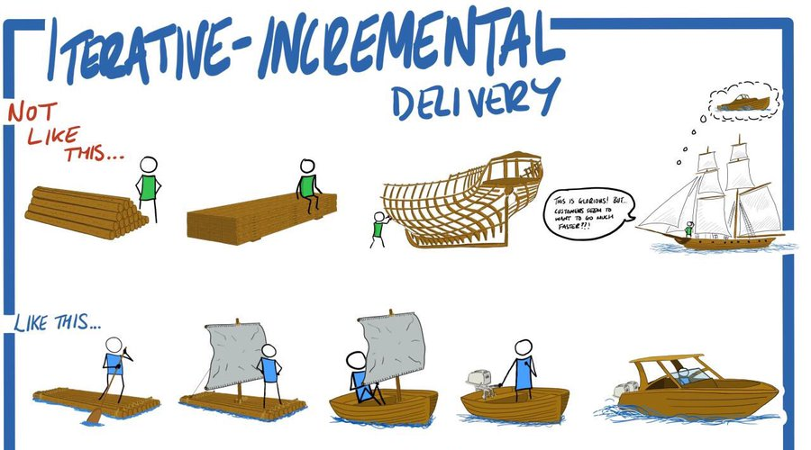
IRL => Agile - Incremental Delivery
Notes:
The traditional way of building physical things, like houses, bridges, boats... is to build the whole thing as one massive project. (explain)
There are a number of problems with this approach:
Nobody can use the product until the very end
You have no idea if it’s actually going to work, until the very end, and then it’s too late to do anything about it
If something happens and the project is delayed or money runs out, you have nothing!
When we are building software, we prefer to do it this way.
We build small simple things that we can deliver to the user straight away. Not only can he start using it very quickly, but he can give us feedback for the next version. Also, he might decide he’s happy with version 4 and then we can stop. Or if the money runs out, at least you have something useful.
The reason I mention this is that for the programming exercise you are about to do, you will naturally want to build things the first way. You will get super excited and try to make it fancy. And you will probably run out of time and end up with nothing. So I’m going to guide you through the programming exercises, in an incremental fashion. Each question will have an a) b) c) option with a) being the first easy version, and c more complicated. If you only have time to complete a), you will still have something which works!

Slide 12
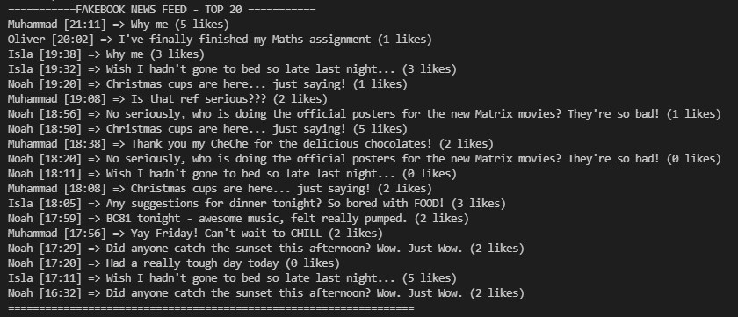

Fakebook News Feed Let’s get started!
Notes:
https://replit.com/@JackieU/FakeBook
https://replit.com/@JackieU/FakeBookSolution

Slide 13

Build a FakeBook News Feed
PLAN - 10 mins
You’ve been tasked with building a FakeBook News Feed.
Brainstorm in groups of 4. Find a project space to display your ideas.
Task 1 - Design
Come up with a very high level design for your FakeBook system
What are the parts of your Fakebook system?
What do you need to build?
Draw your ideas on a piece of paper.
Task 2 - Requirements Analysis
What tasks will you need to do to build the system?
What are the most important tasks? Which tasks will you do first?
Write your ideas down on post-it notes and arrange them in order.
Remember: Incremental Development
First build the simplest thing that will work, then add more fancy features
if you have time.
Notes:
Equipment: Paper, Post-it notes, Bluetac, Markers. Wall space to put the ideas up?

Slide 14

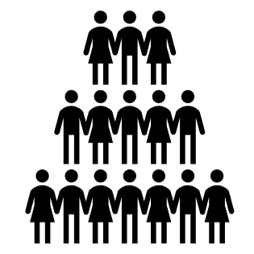


PLAN - Design
PLAN
The system has a list of USERS
Each user will have a group of FRIENDS
A user can POST a message which only his friends can see
A user needs to be able to read recent messages from his friends…
this is what we call a NEWS FEED
message
post a message
message
message
message
USERS
USER
FRIENDS

Slide 15
PLAN - Requirements Analysis
PLAN
Task List
1. Build and Display a List of Users
2. Build and Display a List of Friends
3. Check if a User is a Friend
4. Randomly Generate some Posts for Testing
5. Add Friends
6. Build a News Feed
7. Add a Post
8. Like a Post
*Assume we are already logged in for a single user.

Slide 16
DO - Let’s build it!
DO - 30 mins
Fast forward a week and your team has already completed these features:
1. Build and Display a List of Users - DONE
2. Build and Display a List of Friends - DONE
3. Check if a User is a Friend - DONE
4. Randomly Generate some Posts for Testing - DONE
Test the features your team already wrote,
and then work on the remaining tasks:
5. Add Friends
6. Build a News Feed
7. Add a Post
8. Like a Post
Work in pairs. Assume we are already logged in for a single user.

Slide 17
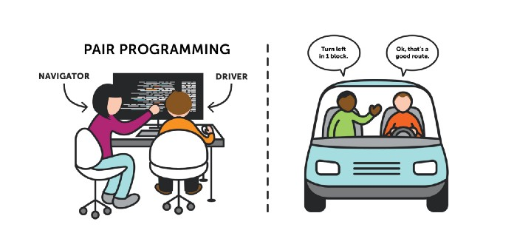
IRL => Pair Programming
DO
Notes:
The traditional way of building things, like houses, bridges, boats... is to build the whole thing as one massive project. (explain)
There are a number of problems with this approach:
Nobody can use the product until the very end
You have no idea if it’s actually going to work, until the very end, and then it’s too late to do anything about it
If something happens and the project is delayed or money runs out, you have nothing!
When we are building software, we prefer to do it this way.
We build small simple things that we can deliver to the user straight away. Not only can he start using it very quickly, but he can give us feedback for the next version. Also, he might decide he’s happy with version 4 and then we can stop. Or if the money runs out, at least you have something useful.
The reason I mention this is that for the programming exercise you are about to do, you will naturally want to build things the first way. You will get super excited and try to make it fancy. And you will probably run out of time and end up with nothing. So I’m going to guide you through the programming exercises, in an incremental fashion. Each question will have an a) b) c) option with a) being the first easy version, and c more complicated. If you only have time to complete a), you will still have something which works!

Slide 18
Task 1 - Test Existing Features
DO
Fast forward a week and your team has already completed these features:
1. Build and Display a List of Users - DONE
2. Build and Display a List of Friends - DONE
3. Check if a User is a Friend - DONE
4. Randomly Generate some Posts for Testing - DONE
Test the features your team already wrote:
print_users()
print_friends()
print(is_friend("Jackie"))
print(POSTS)

Slide 19
Task 2 - Add Friends
DO
You have no friends!
How sad...
Let’s fix that by adding some friends:
a) Hard-code adding a friend
b) Ask the user to choose a friend’s name
c) Ask the user to enter 5 friends’ names
# HINTS
# you can add a friend like this
add_friend('Jackie')
# you can get input from the user like this
some_input = input("Get input from user")
# you can use a for loop to repeat some code
for i in range(0,5):
<do something here>

Slide 20
Task 2 - Add Friends
DO
#a)
add_friend('Noah')
add_friend('Isla')
add_friend('Adam')
add_friend('Muhammad')
add_friend('Oliver')
#b)
friend = input("Please choose a friend: ")
add_friend(friend)
#c)
print("You can choose 5 friends.")
for i in range(0,5):
friend = input("Enter a friend's name: ")
add_friend(friend)
#CHECK IF YOU HAVE ANY FRIENDS NOW?
print_friends()
print("Is Noah a friend?")
print(is_friend("Noah"))
print("Is Mayaa friend?")
print(is_friend("Maya"))

Slide 21

Task 3 - News Feed
DO
Trying to display the POSTS just doesn’t seem to work - it’s a MESS!
There are just far too many to read and it doesn’t look pretty…
a) Build a News Feed to display all Posts
b) Build a News Feed to display only Posts from a Friend
c) Build a News Feed to display only Posts from your Friends
d) Build a News Feed to display only the last 20 Posts
from all your Friends
# HINTS
# you can loop through the posts
for post in POSTS.values():
print(post)
# you can check which user posted the msg
post.name
# you can check if a user is a friend
is_friend("Jackie")

Slide 22
Task 3 - News Feed
DO
#a)
print("FAKEBOOK NEWS FEED")
for post in POSTS.values():
print(post)
#b)
print("FAKEBOOK NEWS FEED - Noah ONLY")
for post in POSTS.values():
if post.name == "Noah":
print(post)
#c)
print("FAKEBOOK NEWS FEED - FRIENDS ONLY")
for post in POSTS.values():
if (is_friend(post.name)):
print(post)
#d)
print("FAKEBOOK NEWS FEED - TOP 20")
post_count = 0
for post in POSTS.values():
if is_friend(post.name) and (post_count < 20):
print(post)
post_count = post_count + 1

Slide 23

Task 4 - Add and Like Posts
DO
Time to start interacting with the world!
a) Add a Post
b) Like the Post you Added
c) Like all Posts from a Friend
# HINTS
# you can add a post like this
post_id = add_post("User", "Your Message Here")
# you can see the likes of a post
POSTS[post_id].likes

Slide 24
Task 4 - Add and Like Posts
DO
#a)
post_id = add_post("Noah", "Hey Guys Whatsuuuuuuuuuuuupppppp")
#b) Like a Post
POSTS[post_id].likes += 100
#c) Like all Posts from a Friend
for post in POSTS.values():
if post.name == "Isla":
post.likes += 100

Slide 25
Extension Ideas
DO
1. Change the names of the 20 Users and change the Random Messages
2. Generate 200 Random Posts instead of 100
3. Change the way the Post is displayed to look nicer
4. Make sure that no Post is repeated by the same User
5. Have you noticed that there is a bug? When you add a new post, it is displayed last in your feed instead of first. Modify the Post class to save the full timestamp, and sort the posts before displaying them.

Slide 26
TEST - Does it work?
CHECK - 5 mins
Hopefully, as you built each piece of functionality, you tested it and checked that it worked.
Now… let’s deliver it to the customer!
Invite someone from another team to check what you have built:
Does it work?
Do they like it?
Do they want you to change anything in the next version?

Slide 27
Retrospective
ACT / ADJUST - 10 mins
A Retrospective is when a team reflects on the past to improve the future. We think about what worked, what didn't, and why.
In your original groups of 4, you are going to write down some ideas on post-it notes:
Stop:
Things that were not good that we don’t want to do next time
Start:
Things that would be good to start doing next time
Continue:
Things that we did well that we want to keep doing next time

Slide 28

THE END

Slide 29

Feedback Forms
Please give your honest feedback on today’s session so that we can improve for future sessions!
https://tinyurl.com/LauriannStem

